Slide 1
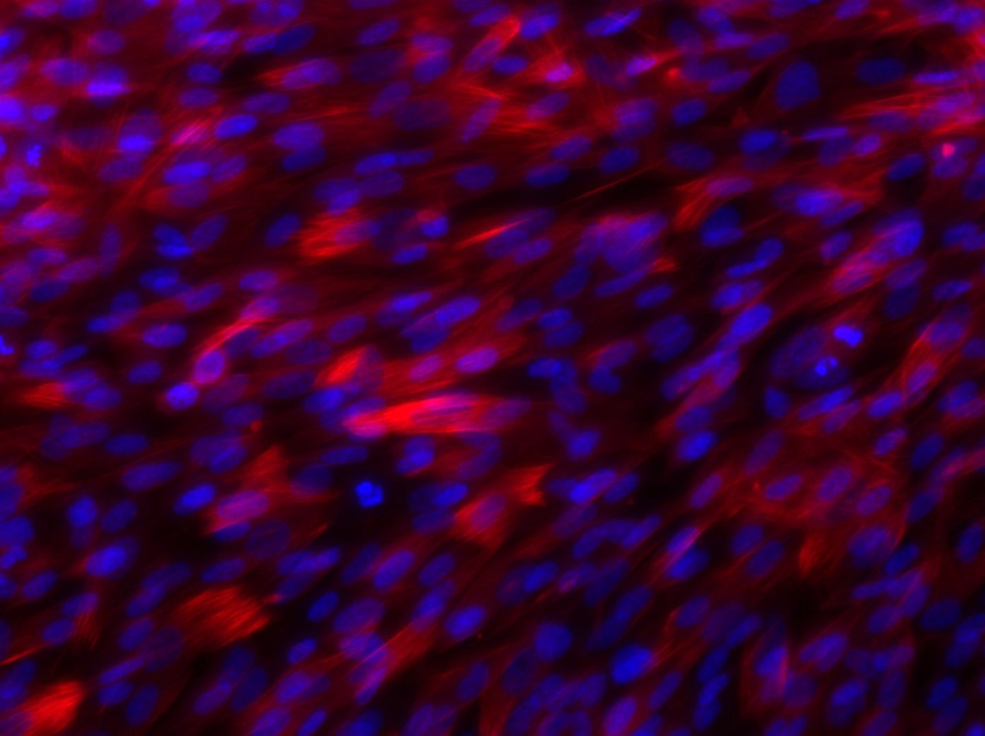
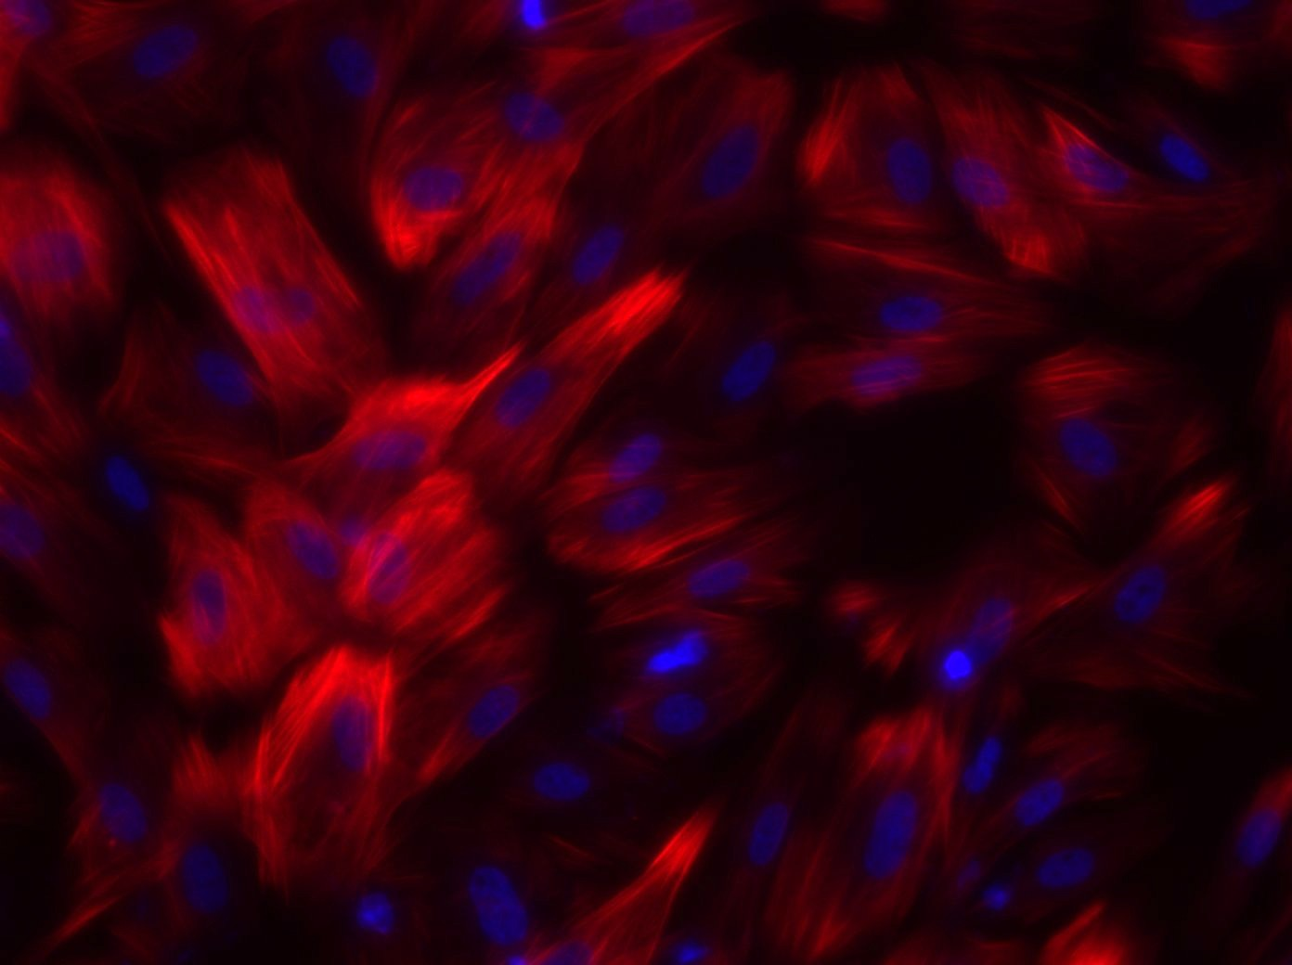
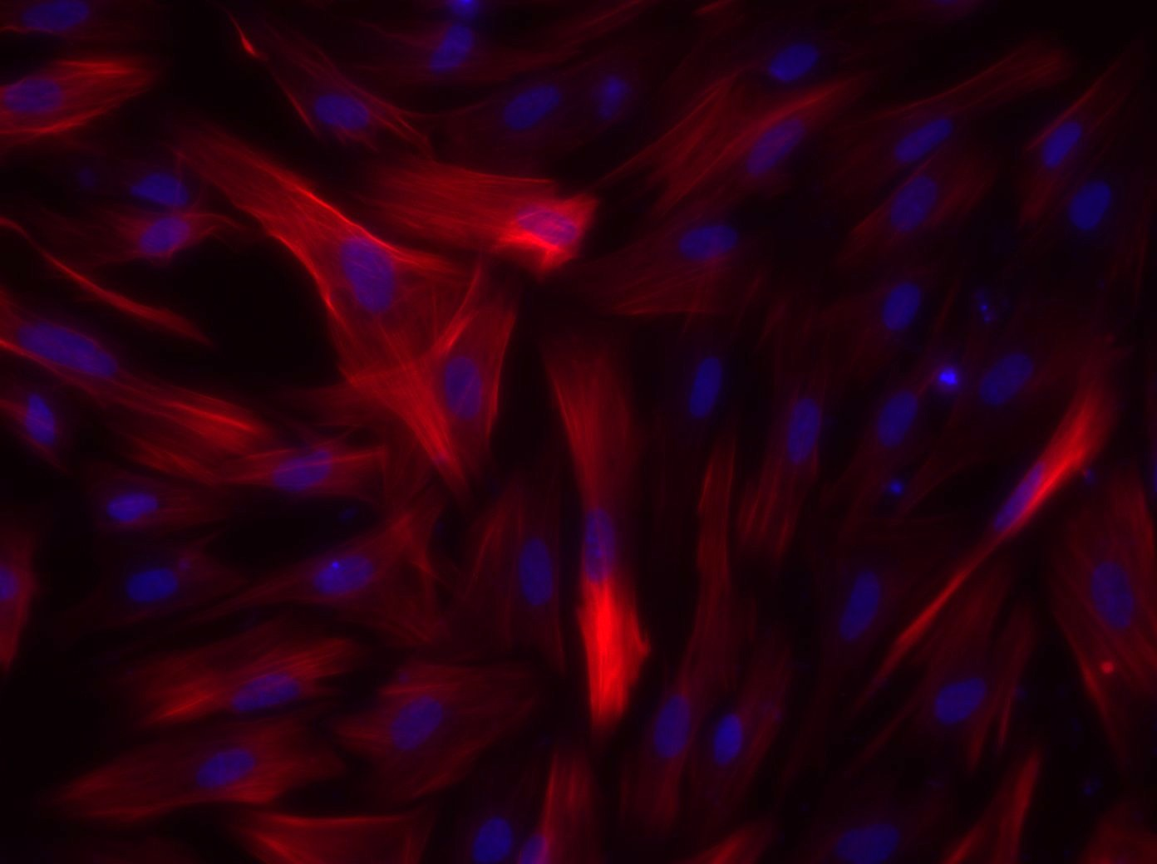
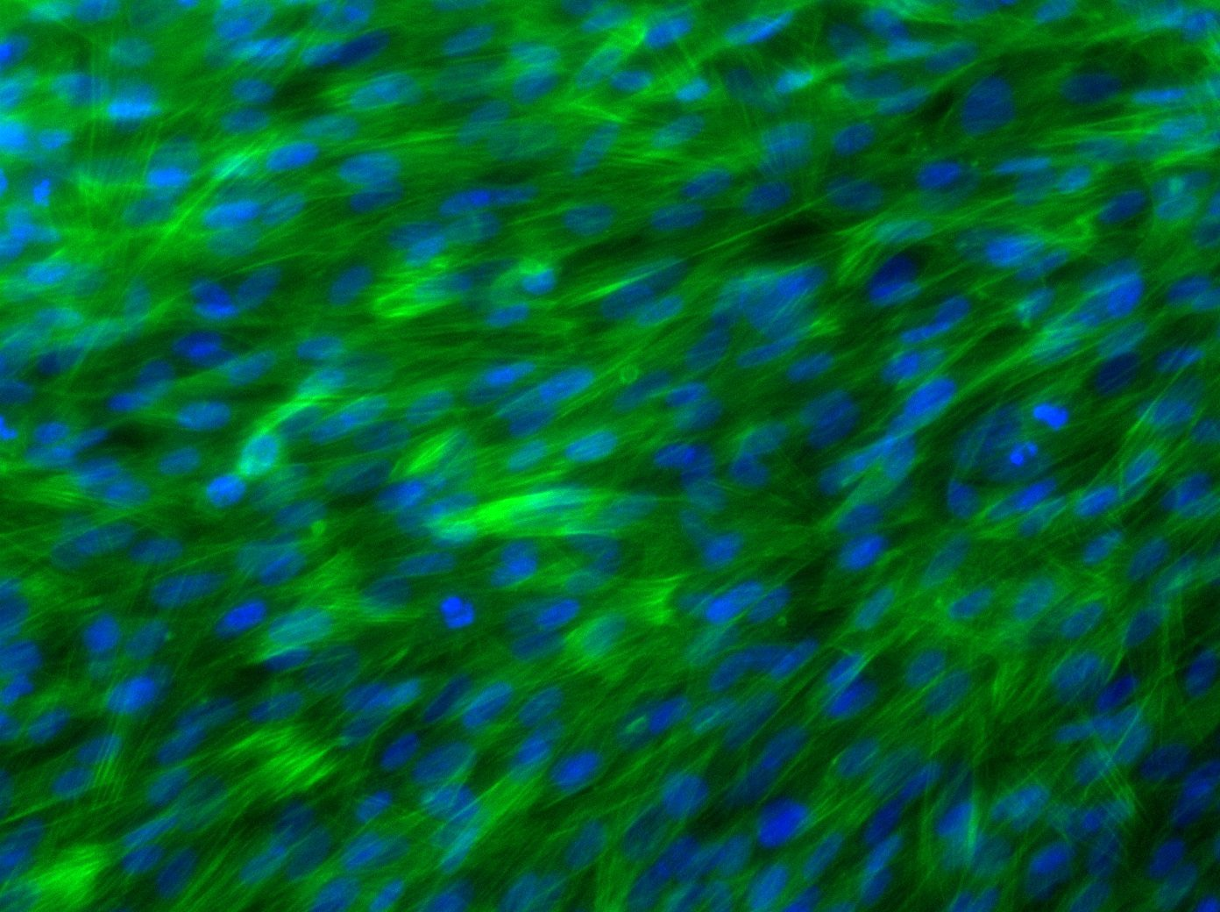
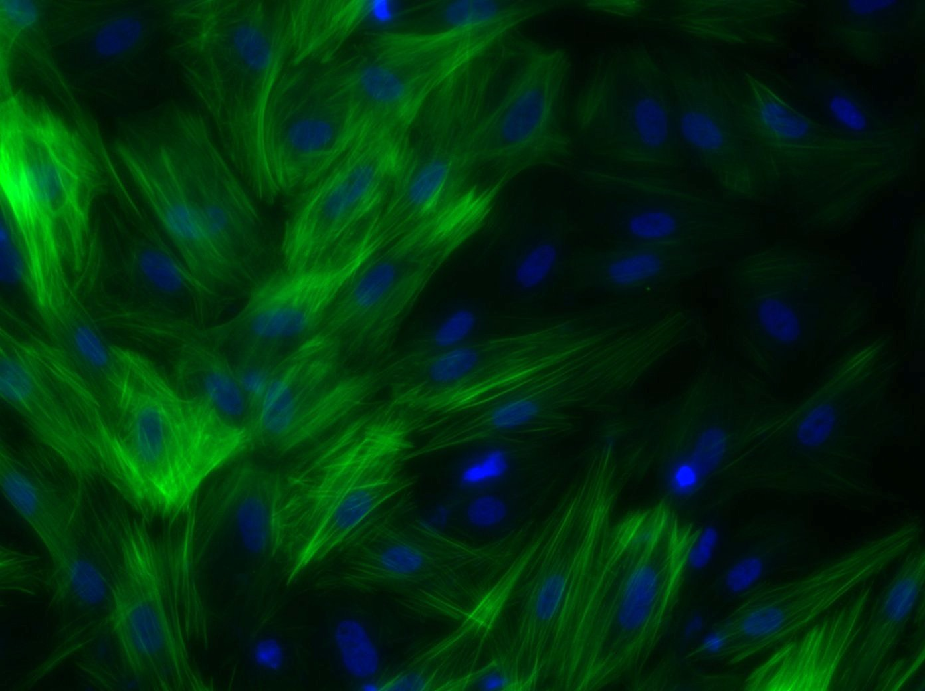
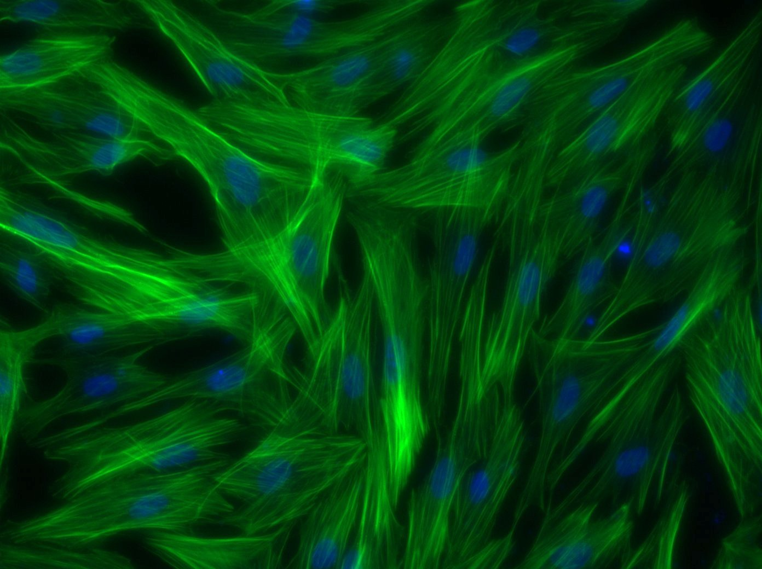
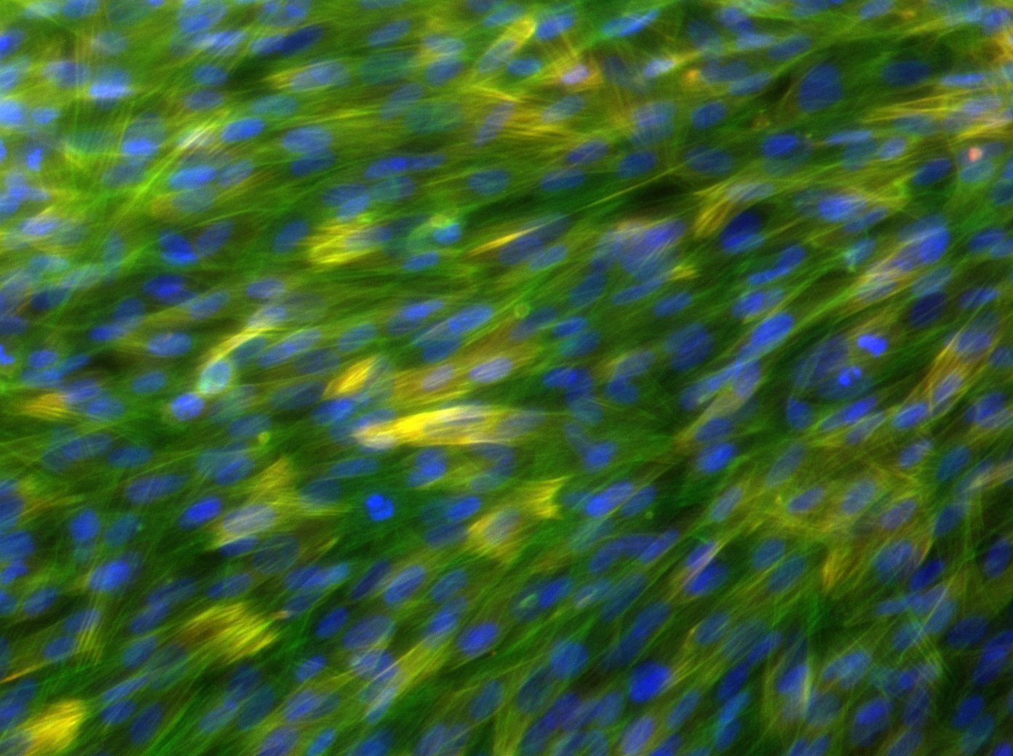
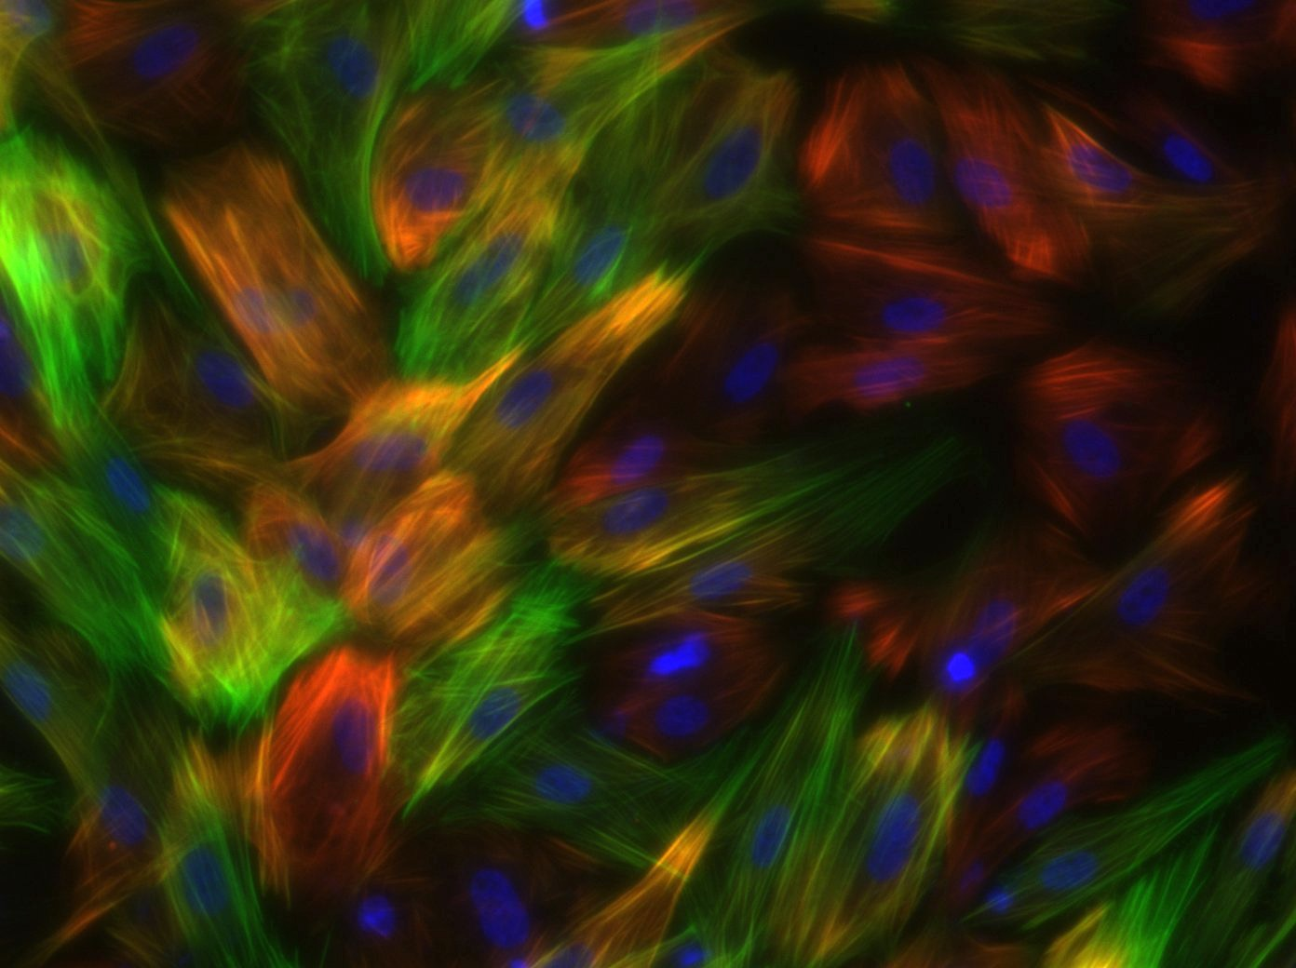
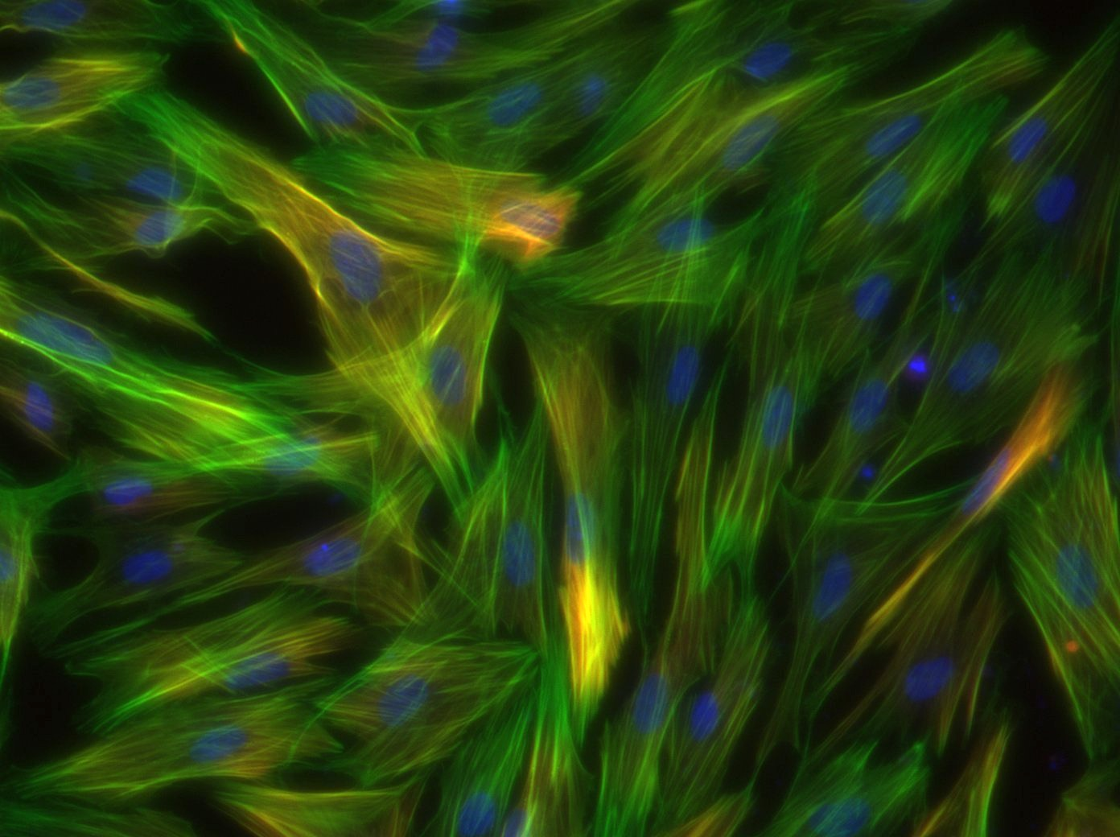
iMSC-G
iMSC-B
iMSC-T
Figure 7. Protein expression of SMC-G, SMC-B, and SMC-T on culture day 4. Images taken at 20X magnification showing expression of calponin (red, top), f-actin (green, middle), DAPI (blue, all), and merged (bottom)
Figure 8. qPCR analysis of SMC-G, SMC-B, and SMC-T on culture day 4. Profiles for α smooth muscle actin (top left), calponin (top middle), smoothelin (top right), elastin (bottom left), cyclin d1 (bottom middle), *p<0.05 one-way ANOVA

